Slide 1
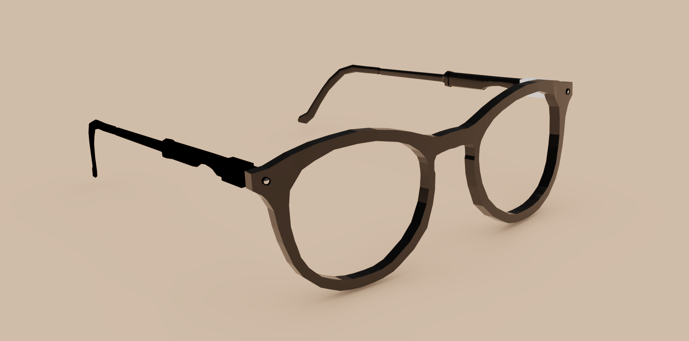
LieWear
MIX301 AUTMN 2021
Sunniva Eide Marcus Leikfoss Swensen Simon Iden

Slide 2
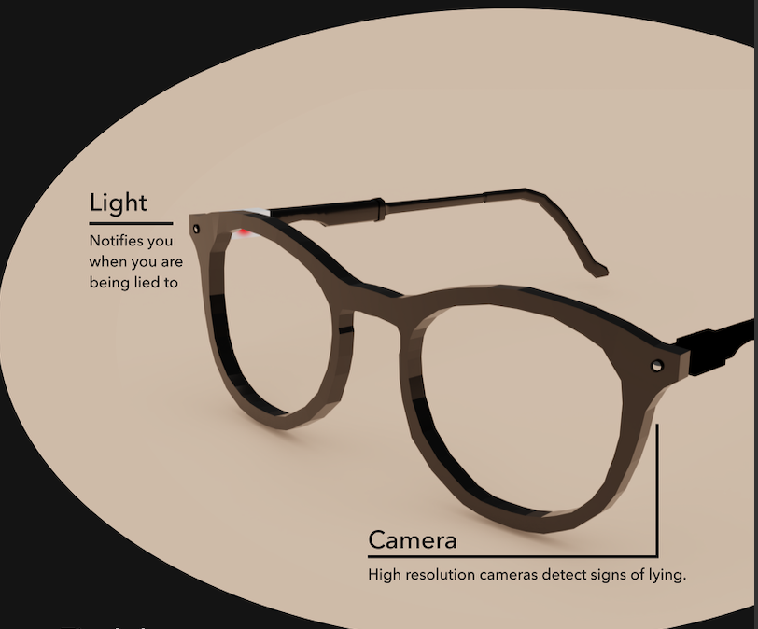
GENERAL IDEA
Detects lies and deception from real time video through facial recognition technology
Designed with discretion in mind
Simple and common eyewear design
Hidden camera
No exterior notifications of video being recorded
Disregarding privacy

Slide 3
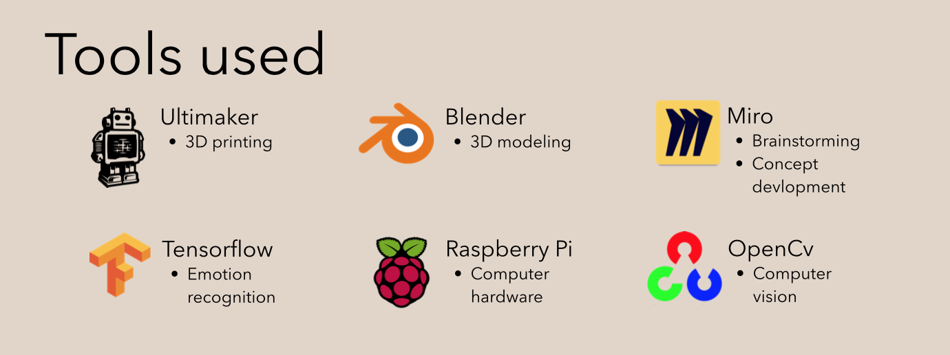
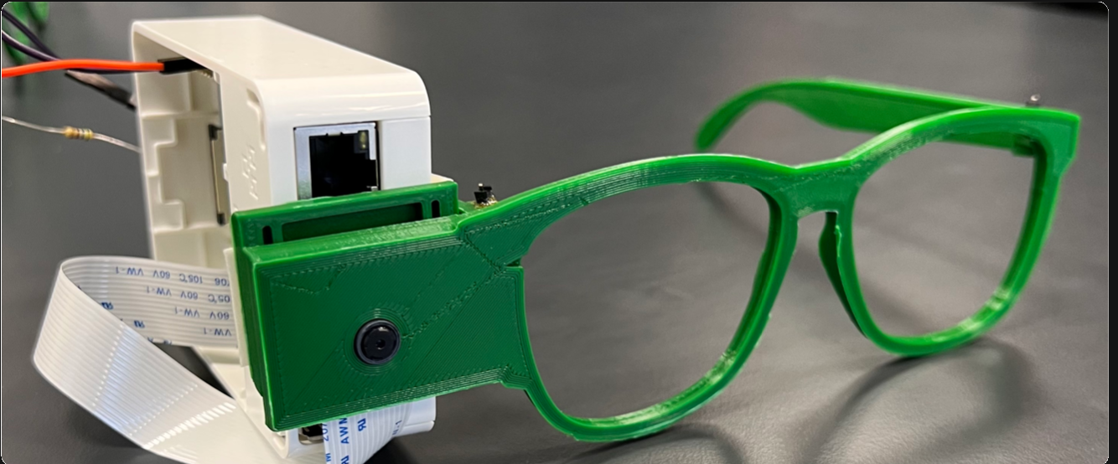
Prototype

Slide 4
GDPR
In general: Uses Facial recognition technology (FRT) Processing personal data, regulated by GDPR (2016) article 9 (1)
Personal use:
Only detect a lie
Save identities and facial expression to learn about individual lying pattern
Law enforcement use:
Would have to comply with Law Enforcement Directive (2016) article 10.

